Slide 1

School of Computing Science and Engineering
Course Code : Course Name: Data mining and web Algo
Unit – 1
Data Mining
Faculty Name: Mr. Soumalya Ghosh Program Name: B.Tech CSE

Slide 2
What is Data Mining?
Data mining is the process of
extracting knowledge or insights from large amounts of data
using various statistical and computational techniques.
The primary goal of data mining
is to discover hidden patterns and relationships in the data that can be used to make informed decisions or predictions.

Slide 3
What is Data Mining?
This involves exploring the data using various techniques such as
Clustering
Classification
regression analysis,
association rule mining
anomaly detection.

Slide 4
Data Mining: Applications
Data mining has a wide range of applications across various industries, including marketing, finance, healthcare, and telecommunications.
For example,
in marketing,
data mining can be used to identify customer segments and target marketing campaigns
in healthcare
it can be used to identify risk factors for diseases and develop personalized treatment plans.

Slide 5
Evolution of Database Technology
The Explosive Growth of Data: from terabytes to petabytes
Data collection and data availability
Automated data collection tools, database systems, Web, computerized society
Major sources of abundant data
Business: Web, e-commerce, transactions, stocks, …
Science: Remote sensing, bioinformatics, scientific simulation, …
Society and everyone: news, digital cameras, YouTube
We are drowning in data, but starving for knowledge!
“Necessity is the mother of invention”—Data mining—Automated analysis of massive data sets

Slide 6
Why it is called Data Mining?
Simply stated, data mining refers to extracting or “mining” knowledge from large amounts of data.
The term is actually a misnomer.
Remember that the mining of gold from rocks or sand is referred to as gold mining rather than rock or sand mining.
Thus, data mining should have been more appropriately named “knowledge mining from data,” which is unfortunately somewhat long.
“Knowledge mining,” a shorter term, may not reflect the emphasis on mining from large amounts of data.
Thus, such a misnomer that carries both “data” and “mining” became a popular choice.

Slide 7
Why it is called Data Mining?
Many other terms carry a similar or slightly different meaning to data mining, such as
knowledge mining from data,
knowledge extraction,
data/pattern analysis,
data archaeology
data dredging
Many people treat data mining as a synonym for another popularly used term, Knowledge Discovery from Data, or KDD
Alternatively, others view data mining as simply an essential step in the process of knowledge discovery

Slide 8
Data mining as a step in the process of knowledge discovery
1. Data cleaning (to remove noise and inconsistent data)
2. Data integration (where multiple data sources may be combined)
3. Data selection (where data relevant to the analysis task are retrieved from the database)
4. Data transformation (where data are transformed or consolidated into forms appropriate for mining by performing summary or aggregation operations, for instance)
5. Data mining (an essential process where intelligent methods are applied in order to
extract data patterns)
6. Pattern evaluation (to identify the truly interesting patterns representing knowledge
based on some interestingness measures)
7. Knowledge presentation (where visualization and knowledge representation techniques are used to present the mined knowledge to the user)

Slide 9
Knowledge Discovery (KDD) Process
Knowledge
Data mining—core of knowledge discovery process
Pattern Evaluation
Data Mining
Task-relevant Data
Data Warehouse
Selection
Data Cleaning
Data Integration
Databases

Slide 10
Difference between KDD and Data Mining
Although the two terms KDD and Data Mining are heavily used interchangeably, they refer to two related yet slightly different concepts.
KDD is the overall process of extracting knowledge from data, while Data Mining is a step inside the KDD process, which deals with identifying patterns in data.
And Data Mining is only the application of a specific algorithm based on the overall goal of the KDD process.
KDD is an iterative process where evaluation measures can be enhanced, mining can be refined, and new data can be integrated and transformed to get different and more appropriate results.

Slide 11
Data Mining and Business Intelligence
Increasing potential
to support
business decisions
End User
Decision Making
Data Presentation
Business
Analyst
Visualization Techniques
Data Mining
Data
Analyst
Information Discovery
Data Exploration
Statistical Summary, Querying, and Reporting
Data Preprocessing/Integration, Data Warehouses
Data Sources
DBA
Paper, Files, Web documents, Scientific experiments, Database Systems

Slide 12
Architecture: Typical Data Mining System
Graphical User Interface
Pattern Evaluation
Knowledge-Base
Data Mining Engine
Database or Data Warehouse Server
data cleaning, integration, and selection
Data
Warehouse
World-Wide
Web
Other Info
Repositories
Database

Slide 13
Data Mining: Confluence of Multiple Disciplines
Database
Technology
Statistics
Machine
Learning
Data Mining
Visualization
Pattern
Recognition
Other
Disciplines
Algorithm

Slide 14
Data Mining: On What Kinds of Data?
Database-oriented data sets and applications
Relational database, data warehouse, transactional database
Advanced data sets and advanced applications
Data streams and sensor data
Time-series data, temporal data, sequence data (incl. bio-sequences)
Structure data, graphs, social networks and multi-linked data
Object-relational databases
Heterogeneous databases and legacy databases
Spatial data and spatiotemporal data
Multimedia database
Text databases
The World-Wide Web

Slide 15
Data Mining Functionalities
Multidimensional concept description: Characterization and discrimination
Generalize, summarize, and contrast data characteristics, e.g., dry vs. wet regions
Frequent patterns, association, correlation vs. causality
Diaper → Beer [0.5%, 75%] (Correlation or causality?)
Classification and prediction
Construct models (functions) that describe and distinguish classes or concepts for future prediction
E.g., classify countries based on (climate), or classify cars based on (gas mileage)
Predict some unknown or missing numerical values

Slide 16
Data Mining Functionalities
Cluster analysis
Class label is unknown: Group data to form new classes, e.g., cluster houses to find distribution patterns
Maximizing intra-class similarity & minimizing interclass similarity
Outlier analysis
Outlier: Data object that does not comply with the general behavior of the data
Noise or exception? Useful in fraud detection, rare events analysis
Trend and evolution analysis
Trend and deviation: e.g., regression analysis
Sequential pattern mining: e.g., digital camera → large SD memory
Periodicity analysis
Similarity-based analysis
Other pattern-directed or statistical analyses

Slide 17
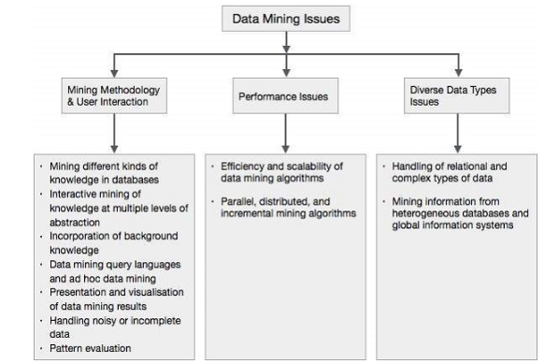
Data Mining - Issues

Slide 18
Data Mining - Issues
Mining methodology
Mining different kinds of knowledge from diverse data types, e.g., bio, stream, Web
Performance: efficiency, effectiveness, and scalability
Pattern evaluation: the interestingness problem
Incorporation of background knowledge
Handling noise and incomplete data
Parallel, distributed and incremental mining methods
Integration of the discovered knowledge with existing one: knowledge fusion
User interaction
Data mining query languages and ad-hoc mining
Expression and visualization of data mining results
Interactive mining of knowledge at multiple levels of abstraction
Applications and social impacts
Domain-specific data mining & invisible data mining
Protection of data security, integrity, and privacy

Slide 19
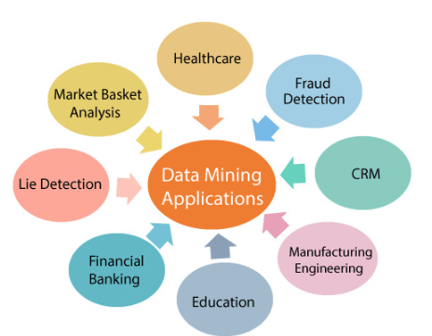
Data Mining Applications

